Slide 1

Automatic Pressure Cooker Whistle Counter and Alerter
1. T. Monish Madhav (21071A66J6)
2. T. Shesvika (21071A66J7)
3. T. Santhosh (21071A66J8)
4. S. S. R. S. Pranav (21071A6957)
5. T. Purna Teja (21071A6958)
6. T. Yogesh (21071A6959)
Mentor Name
Centre for Presencing & Design Thinking
VNRVJIET

Slide 2
Problem Statement
Cooks generally find it difficult to focus their attention on counting the number of whistles while cooking.
Switching off the cooker at wrong number of whistles leads to under-cooked food or over-cooked. This leads to food wastage and poor taste of food.

Slide 3
Value Proposition
Our project will help cooks manage their cooking in a better way.
Less food wastage
Better taste of food

Slide 4


Empathy tool used
- One to One Interviews

Slide 5
Empathy Data
Questions we asked:
What are the problems you face generally while cooking?
How do you feel when that problem occurs?
What would you do to solve the problem if you could?
How would a product like this affect your cooking environment?

Slide 6
Empathy Data
What are the problems you face generally while cooking?
Responses:
Housewife: "One of the challenges I face is keeping track of multiple things on the stove while managing household tasks. It's easy to lose count of whistles, especially when I'm busy with other chores."
Chef: "Timing is crucial in the kitchen, and sometimes, with a bustling restaurant environment, it's challenging to focus on the precise number of whistles. It can lead to slight variations in the doneness of dishes."
Student: "I'm always multitasking, studying while cooking. Sometimes, I forget about the food on the stove, and it results in either undercooked or burnt meals. It's a real struggle."
Elder People: "As an older person, I find it difficult to stand in the kitchen for long periods. Remembering the number of whistles is a task, and I often worry about leaving something unattended on the stove."
Bachelor Living Alone: "Cooking for myself, I often get distracted with work or entertainment. Forgetting about the cooker can ruin a meal. It's a hassle to keep track of everything, and it happens more often than I'd like."

Slide 7
Empathy Data
How do you feel when that problem occurs?
Responses:
Housewife: "It's frustrating and stressful. I put effort into making a good meal, and realizing I've lost track of whistles makes me worry about the taste and quality of the food."
Chef: "In a professional kitchen, precision is key. When I miss the exact whistle count, it can affect the consistency of the dishes. It's a bit disheartening."
Student: "It's irritating because I have limited time, and having to deal with overcooked or undercooked food is an unnecessary hassle. It affects my schedule."
Elder People: “It makes me anxious. I want to cook a nice meal for myself, but the fear of forgetting something on the stove and ruining it is always there."
Bachelor Living Alone: "It's annoying. I'm trying to simplify my life, and messing up a simple cooking task feels like a setback. Plus, it's a waste of time and ingredients."

Slide 8
Empathy Data
What would you do to solve the problem if you could?
Responses:
Housewife: "If I could, I'd love a system that automatically keeps track of the whistles. It would make my cooking experience much smoother, allowing me to focus on other tasks."
Chef: "Having a reliable timer or alert system specifically designed for chefs in a professional kitchen would be a game-changer. It would help maintain consistency in the dishes."
Student: "I need something that integrates with my study routine. Maybe an app that syncs with my cooker, providing alerts and adjusting to my multitasking lifestyle."
Elder People: "A simple and user-friendly device that takes care of the counting automatically would be great. It should be easy to use and not add more complexity to cooking."
Bachelor Living Alone: "I want a straightforward solution. Maybe an automated whistle counter that's not too techy but helps me avoid burnt dinners when I'm engrossed in something else."

Slide 9
Empathy Data
How would a product like this affect your cooking environment?
Responses:
Housewife: "It would make cooking more enjoyable. Less stress and worry about timings mean I can focus on creating delicious meals for my family."
Chef: “In a professional setting, it would streamline the cooking process. With precise timing, I could ensure every dish leaving the kitchen meets the high standards of the restaurant."
Student: "It would save me from cooking disasters and give me more time for my studies. A product like this would fit seamlessly into my busy lifestyle."
Elder People: "It would bring peace of mind. I could cook without constant fear of forgetting something. It would make the kitchen a safer and more enjoyable place."
Bachelor Living Alone: It would simplify my cooking routine. I wouldn't have to stress about timers and could confidently focus on my work without the fear of burning my dinner."

Slide 10
Who will be at benefit?
Mainstream users: Elderly people, Students who live in PGs
Extreme users: Scientists in labs
Lead users: Home cooks, Restaurant cooks

Slide 11
Insights from Empathy Stage
Many cooks, especially mothers feel a lot of agony when they are unable to keep count of the whistles.
They feel it would be better if the whistle-counting happens automatically.
Our product would reduce their stress and improve their food and well-being!

Slide 12
Primary Needs
A counter which counts the number of whistles accurately.
Compact, easy to setup and easy to use device.

Slide 13
Secondary Needs
Alert when the number of whistles reach a certain number.
Sending a message to cook’s phone when the above condition occurs.

Slide 14
Latent Needs
The cooker switches off automatically when the number of whistles reaches a threshold.
Setting the whistle threshold automatically based on the type of food.

Slide 15
Our Point of View
This is a very relevant problem in Indian households where people who cook are engaged in other cooking related activities and often forget the count of whistles.
Cooks generally give the job of counting the whistles to children around the house (and usually they don’t do it correctly!)

Slide 16
Ideation Method used
Brainstorming: We sat together and brainstormed few ideas to get to the solution. Some of those ideas are,
Enhanced Buzzer: Idea wad to amplify the existing pressure cooker buzzer and pair it with a distinct sound for each additional whistle.
Whistle Countdown Display: Install a simple LED display on the pressure cooker lid that counts down from your desired number of whistles.
Sticky Note Reminder: Design a set of adhesive whistle count stickers. Users simply stick the corresponding sticker on the cooker before cooking.

Slide 17
Ideation Method used
Pressure sensor: Put a sensor that checks the pressure in the cooker. The sensor then sends the data to user’s phone and then the user can check the pressure and take action accordingly.
Buzzer and notification: Setup a microphone sensor near the cooker and once the threshold is reached, alert the user using a loud buzzer and an email/Bluetooth notification.

Slide 18
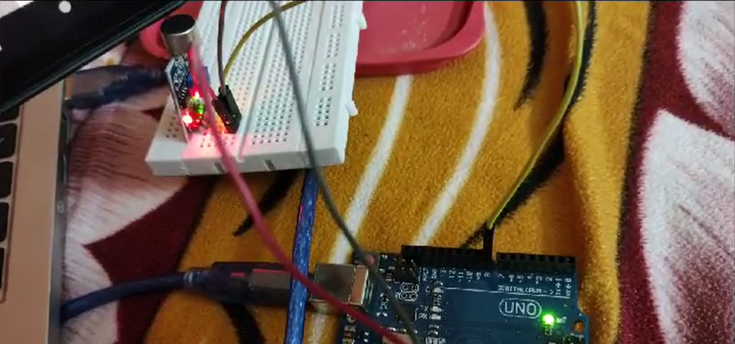
Solution Prototype

Slide 19
Innovation Metrics
Desirability: According to the surveys we did, we got to know that people desperately want a solution like our product. They said they will use a product like this.
Feasibility: The components are cheap (cost around ₹50) except for the Arduino board. We must find a workaround for the Arduino like using a smaller and simpler board.
Viability: User struggle with pressure cooker whistles is real, our solution addresses it, further testing can confirm market fit and refine our product's potential.

Slide 20
Team experience
Monish : “It was great team coordinated project where I learnt many new things about IOT sensors”
Shesvika: “Collaboration was nice”
Santosh: “Felt nice working with people from other branch”
Pranav: “Great idea for a project, thoroughly enjoyed the prototyping process!”
Purna Teja: “Nice experience!”
Yogesh: “Cool👍”

